Slide 1
Alphabet Recognition of Speech Signals
Vivek Muskan 2017MT10755
Deepak Kumar 2017PH10813
ELL205 – Course Project

Slide 2
Types of Speech Recognition System
Speech recognition system are designed based on :
Number of Speakers
Nature of Utterance
Vocabulary Size
Number of Language (Continuous vs Combination of Phonemes)
Spectral Bandwidth

Slide 3
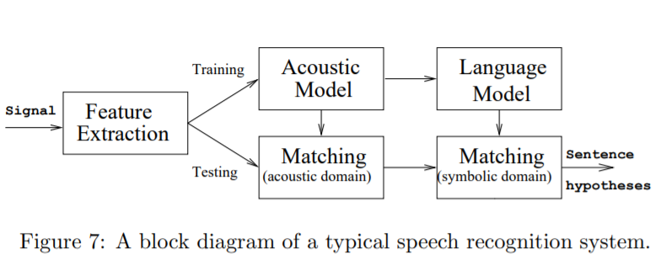
Basic Idea of Speech Recognition
Input Speech
ADC
Amplitude Normalize
Noise Filtration
Feature Extraction
Word Mapping (HMM)
Output

Slide 4
Feature Extraction Method
Perceptual Linear Prediction (PLP)
Relative spectra of log domain coefficients PLP (RASTA-PLP)
Linear Predictive Coding (LPC)
Predictive cepstral coefficients (LPCC)
Mel scale cepstral analysis
Mel-frequency cepstral coefficients (MFCC)
Outdated:
Power spectral analysis (FFT)
Energy Normalization

Slide 5
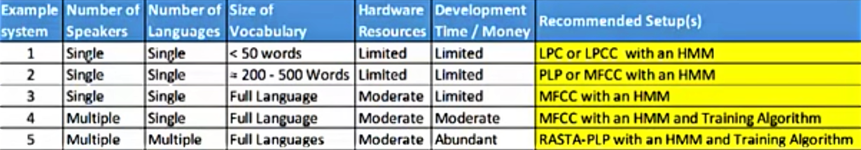
Limits of Feature Extraction Algorithms

Slide 6
Project Requirement
Vocabulary Size : 26
Number of Language : 1 (English)
Number of Speaker : 1
Nature of Utterance : Single Phoneme (Mostly)

Slide 7
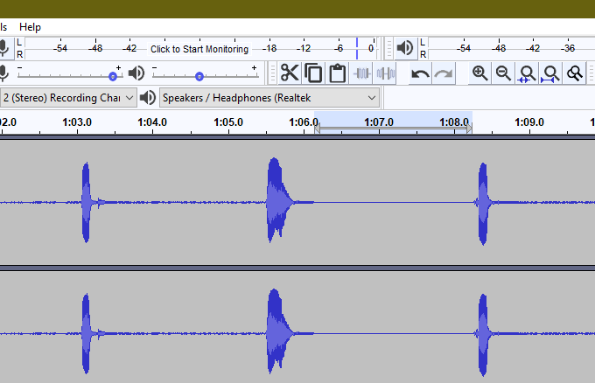
Our Implementation
Noise Filtration – Audio Software (Audacity)
Feature Extraction – Matching using Cross-Correlation
X Y Z

Slide 8
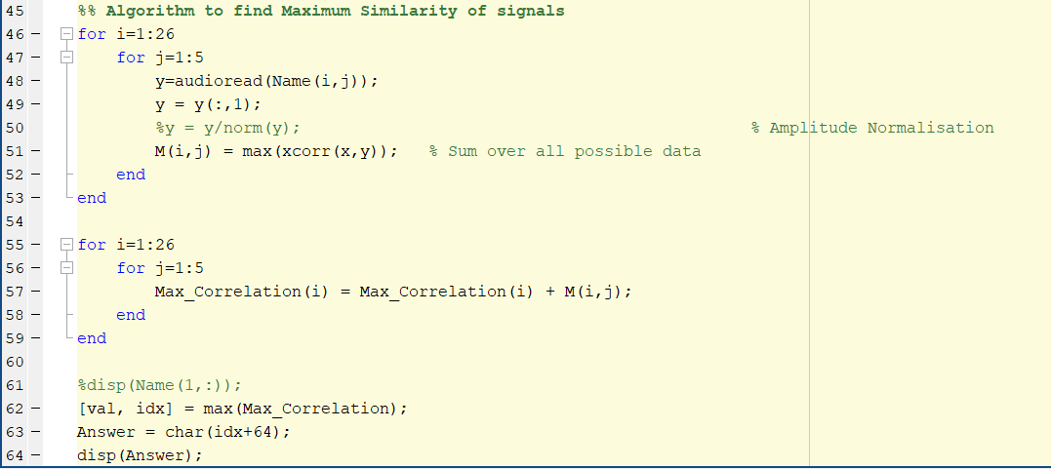
Cross-Correlation
Used to measure similarity between two signals
Similarity is directly proportional to value of Correlation
Snapshot from MATLAB Code

Slide 9
Demo

Slide 10
Thank You

